Slide 1


MOOD PICTURE
Project I - Masters in Creative Computing and AI
Alan Nunes Caetano

Slide 2

Goals
The main goal of this project is to make people reflect about the mood of their environment perceived through sounds.

Slide 3
"The growth in noise pollution is unsustainable because it involves direct, as well as cumulative, adverse health effects."
World Health Organization. (1999, April). "Guideline for community noise".
Retrieved from https://www.who.int/docstore/peh/noise/Comnoise-1.pdf

Slide 4

Use case
The first use case to be explored is collective environments.
Workplaces
Home

Slide 5




Use case
The sensor is turned on.
The users share the environment.
The sensor is turned off.
User's mood perception.
Animation is generated.

Slide 6


Functionalities
Gather data that could represent the environment mood.
Generative art as a meaningful output.

Slide 7


Functionalities
Stress perception as an AI processed output.
Individual streak to incentive self improvement.

Slide 8


System structure
User input
Generative output
Data storage
Intelligent agent
Sound sensor
Good results streaks.

Slide 9
Modules
IoT
AI
Creative computing
Gamification

Slide 10
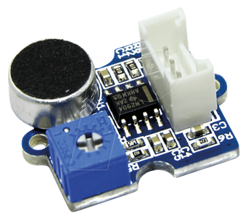
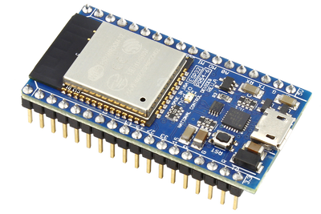
IoT module
Loudness Sensor LM2904
ESP32 module with Wi-Fi

Slide 11

IoT module
{
MaxAmplitude : Int,
AvgAmplitude : Int
}
HTTP Post
Data storage

Slide 12

AI module
Sensor readings
{
MaxAmplitude : Int,
AvgAmplitude : Int
}
Stress indicator
Intelligent agent
(Tau Prolog)
User's mood perception

Slide 13
AI module
"The capacity of a noise to induce annoyance depends upon its physical characteristics, including the sound pressure level, spectral characteristics and variations of these properties with time. "
"All measures consider the frequency content of the sounds, the overall sound pressure levels and the variation of these levels with time."
World Health Organization. (1999, April). "Guideline for community noise".
Retrieved from https://www.who.int/docstore/peh/noise/Comnoise-1.pdf

Slide 14
AI module
Rules to stressful periods perception:
Sound intermittency (Max / Average amplitude);
Calibration of sensibility with the user input;
Residual stress calculated with 5 last periods:
on the 3 consecutive last periods being stressful;
on the 5 last periods being intermittent;
on the 5 last periods having 4 stress periods.

Slide 15
Creative Computing module
Generative art;
p5.js library;
Particle system.

Slide 16
Creative Computing module
Environment mood in 2 dimensions:
Stress indicator defines the particle's temperature;
Max amplitude defines the particle's dispersion speed.

Slide 17
Gamification module
Good mood streak.
* It was decided that the gamification will be restricted to an individual streak due to the theme subjectivity.

Slide 18
Demonstration

Slide 19

Conclusions
Importance of raising awareness about noise pollution indoors;
Make people reflect;
Try to encourage changes on the environment and behaviour.

Slide 20

Future work
Include more sensors;
Add data from health APIs (like Apple Health);
Improve the intelligent agent with experts knowledge.

Slide 21

Questions?

